Slide 1
What is Numerical Calculation?
By: Iman Khani Jazani
AI and Data Specialist, Business Developer | AiHum
Adjunct Professor | Sharif University of Technology
Senior Data Scientist, Community builder | Adin

Slide 2
Last Lecture
Short Presentations
Review the last lecture
Data story telling
Visualization in Python!
Application of Programming in the Digital Age!

Slide 3
Today
Short Presentations
Random number generation
Sampling from distribution
Introduction to linear algebra with Numpy
Introduction to SciPy
Application of Programming in the Digital Age!

Slide 4
Together
Send your feedback about the class whenever you want!

Slide 5

Contact me
Gmail: ImanKhaniJazani@gmail.com
LinkedIn: https://www.linkedin.com/in/ImanKhaniJazani/
Telegram: @IKJ1992

Slide 6
Short Presentations

Slide 7
Review the Last Lecture

Slide 8
DST Procedure
Feed data
Clean data
EDA
Make questions
Extract insights
Visualize insights

Slide 9
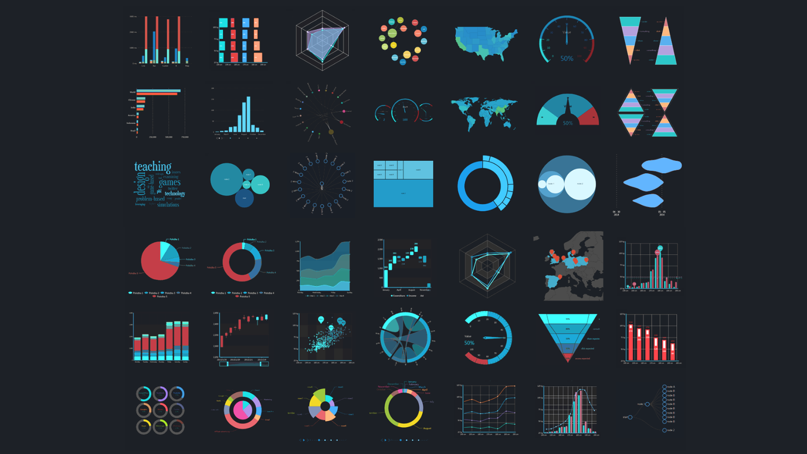
Different Charts!

Slide 10
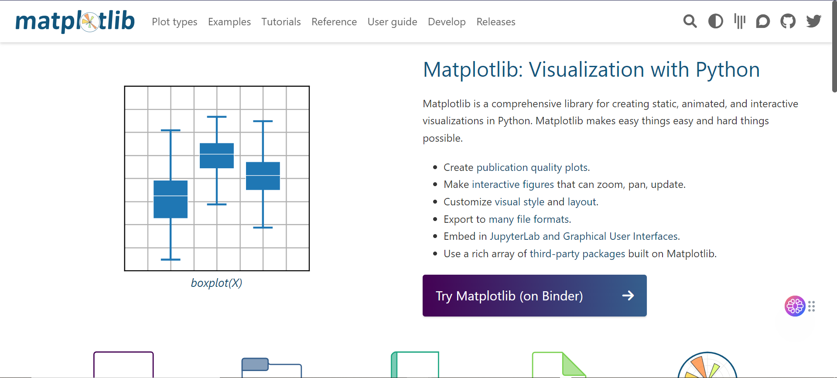
Let’s go to matplotlib.org!

Slide 11
DST Procedure
Feed data
Clean data
EDA
Make questions
Extract insights
Visualize insights

Slide 12
Different Charts!

Slide 13
Let’s go to matplotlib.org!

Slide 14
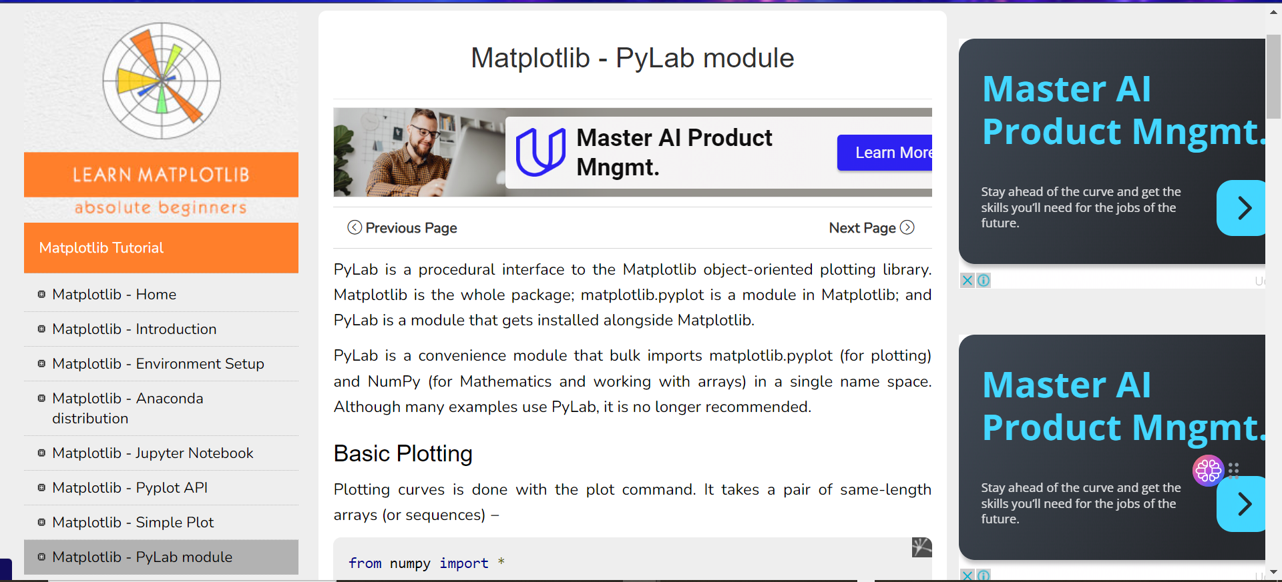
PyLab
Notes:
https://www.tutorialspoint.com/matplotlib/matplotlib_pylab_module.htm#

Slide 15
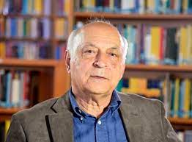
Thanks to Prof. Shahshahani for his talk in the meeting about Math!

Slide 16
Random Number Generation

Slide 17
History!
People have been using random numbers for millennia, so the concept isn't new. From the lottery in ancient Babylon, to roulette tables in Monte Carlo, to dice games in Vegas, the goal is to leave the end result up to random chance.
Generating large quantities of random numbers requires great deal of time and work. Thanks to human ingenuity, we have more powerful tools and methods at our disposal.

Slide 18
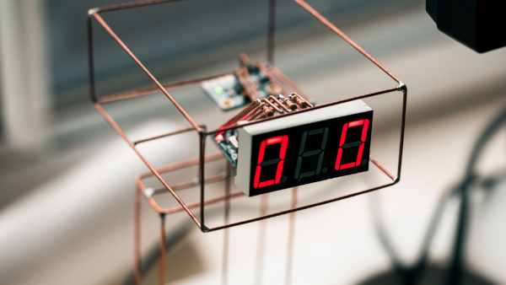
True Random Number Generator
A true random number generator (TRNG), also known as a hardware random number generator (HRNG), does not use a computer algorithm. Instead, it uses an external unpredictable physical variable such as radioactive decay of isotopes or airwave static to generate random numbers.

Slide 19
Pseudo-Random Number
As an alternative to "true" random numbers, the second method of generating random numbers involves computational algorithms that can produce apparently random results.
Why apparently random? Because the end results obtained are in fact completely determined by an initial value also known as the seed value or key. Therefore, if you knew the key value and how the algorithm works, you could reproduce these seemingly random results.
Notes:
https://www.freecodecamp.org/news/random-number-generator/

Slide 20
Pseudo-Random number generator algorithm
Accept some initial input number, that is a seed or key.
Apply that seed in a sequence of mathematical operations to generate the result. That result is the random number.
Use that resulting random number as the seed for the next iteration.
Repeat the process to emulate randomness.

Slide 21
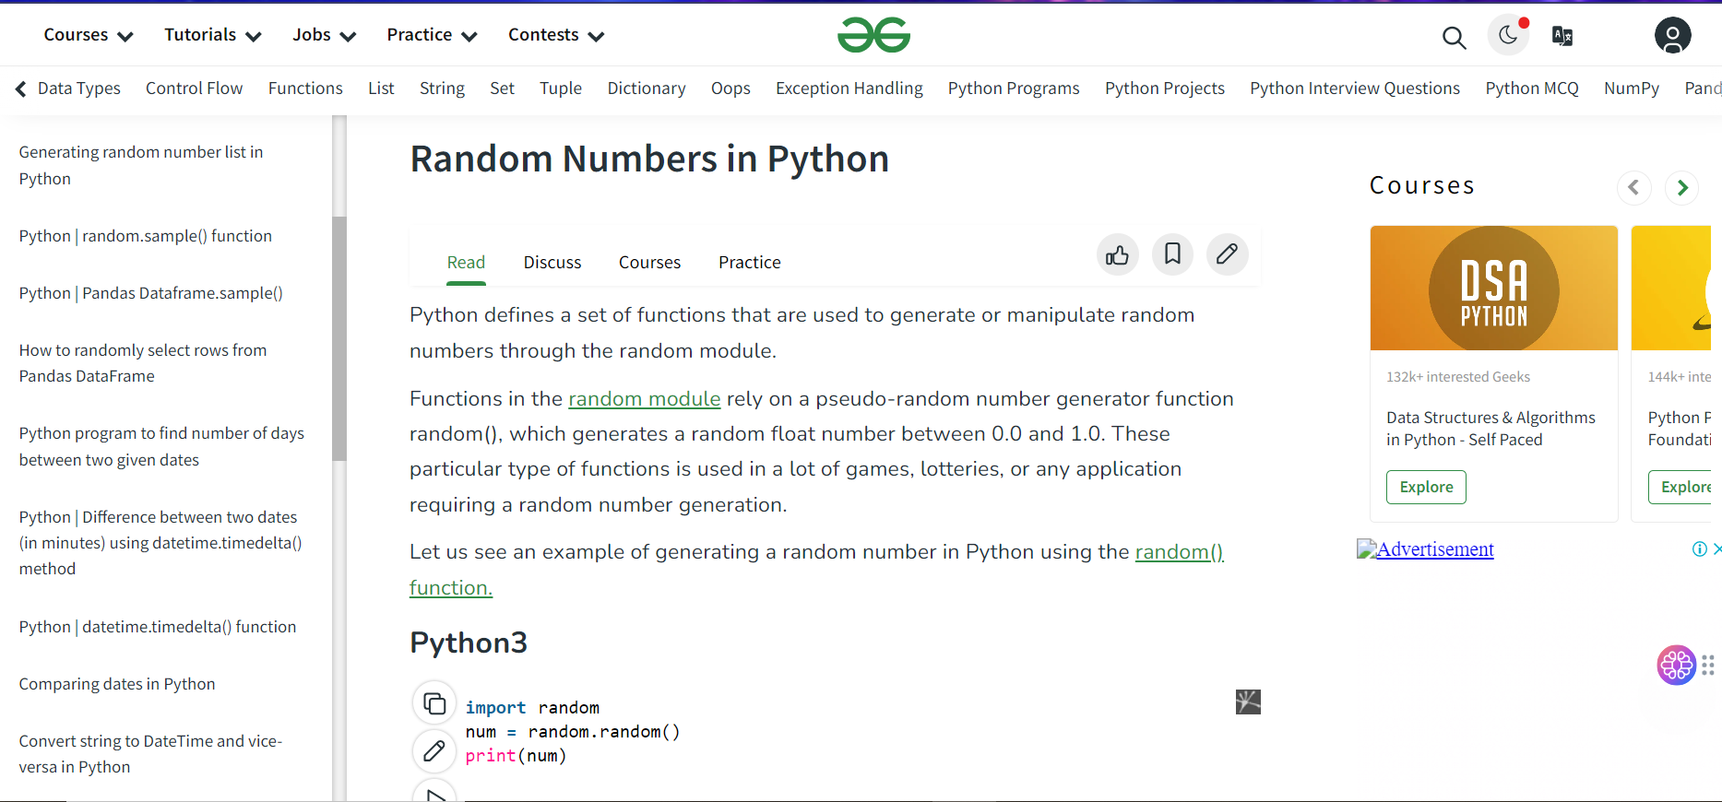
Let’s go to Python!

Slide 22
Sampling from Distribution

Slide 23
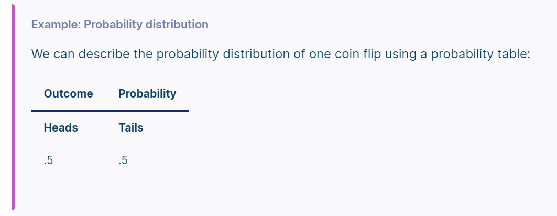
What is distribution?
A probability distribution is a mathematical function that describes the probability of different possible values of a variable. Probability distributions are often depicted using graphs or probability tables.
Notes:
https://www.scribbr.com/statistics/probability-distributions/

Slide 24
Different types of distribution
Bernoulli Distribution
Uniform Distribution
Binomial Distribution
Normal or Gaussian Distribution
Exponential Distribution
Poisson Distribution
Notes:
https://www.analyticsvidhya.com/blog/2017/09/6-probability-distributions-data-science/

Slide 25
What is sampling?
A sample is a subset of individuals from a larger population. Sampling means selecting the group that you will actually collect data from in your research. For example, if you are researching the opinions of students in your university, you could survey a sample of 100 students.
Notes:
https://www.scribbr.com/frequently-asked-questions/what-is-sampling/

Slide 26
What is a sample in Bernoulli distribution?

Slide 27
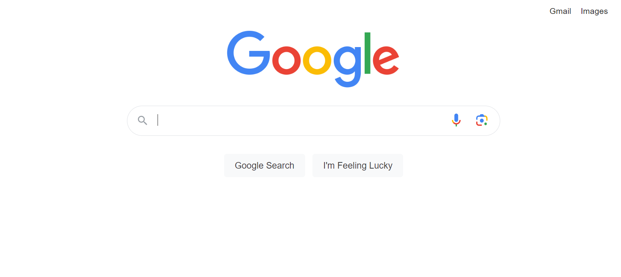
Sampling with Python? Let’s go!

Slide 28
Introduction to linear algebra with Numpy

Slide 29
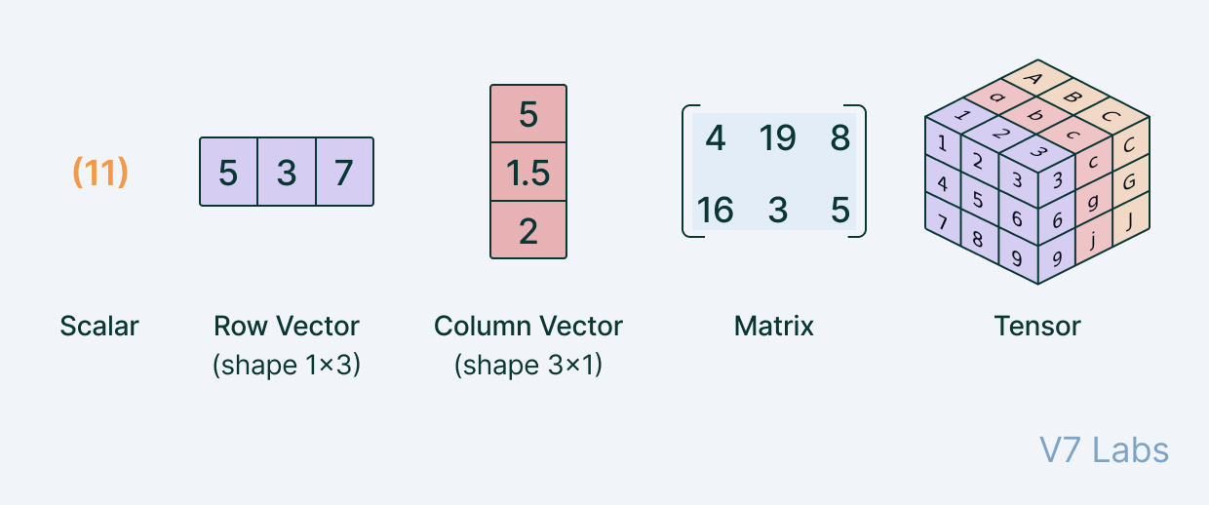
What is vector? matrix? tensor?

Slide 30
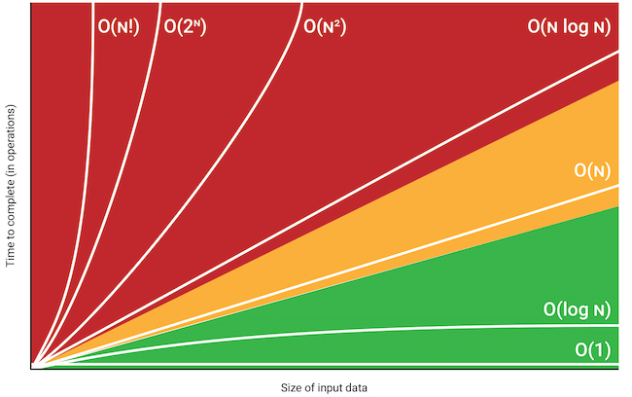
Let’s go to implement in python and time complexity!
scalar * vector
vector + vector
matrix + matrix
matrix * matrix

Slide 31
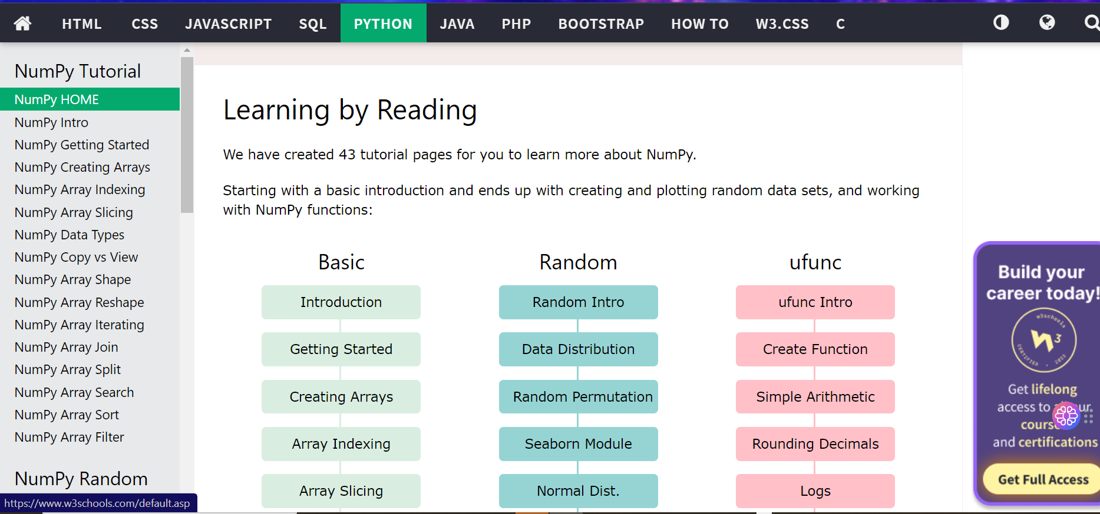
Let’s go to Numpy
Notes:
https://www.w3schools.com/python/numpy/default.asp

Slide 32
Introduction to SciPy

Slide 33
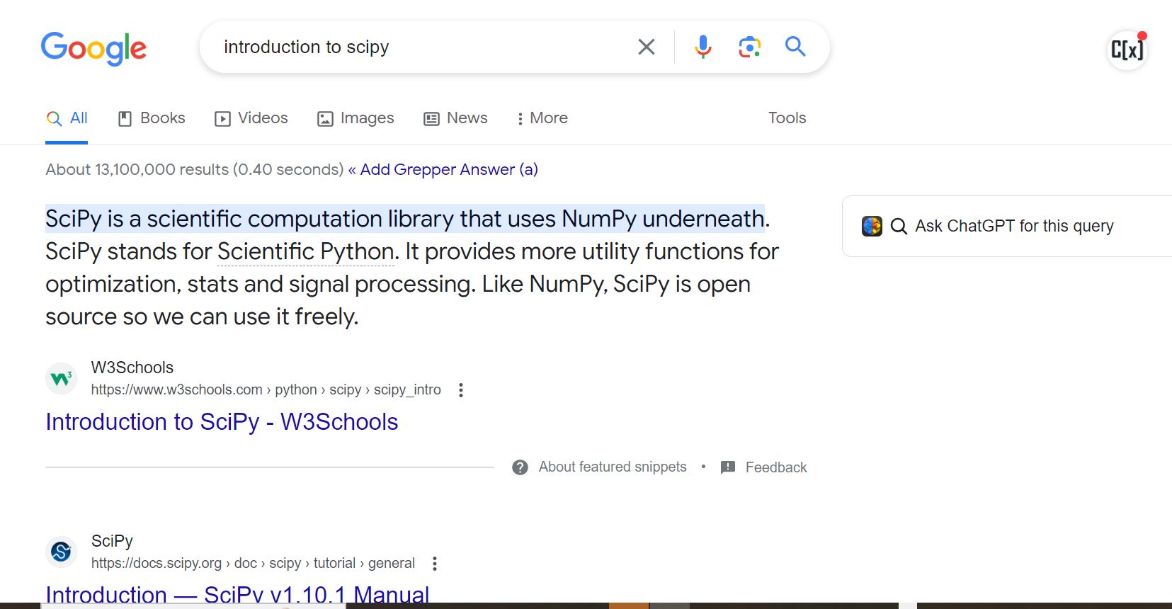
Let’s go!
Notes:
https://www.guru99.com/scipy-tutorial.html

Slide 34
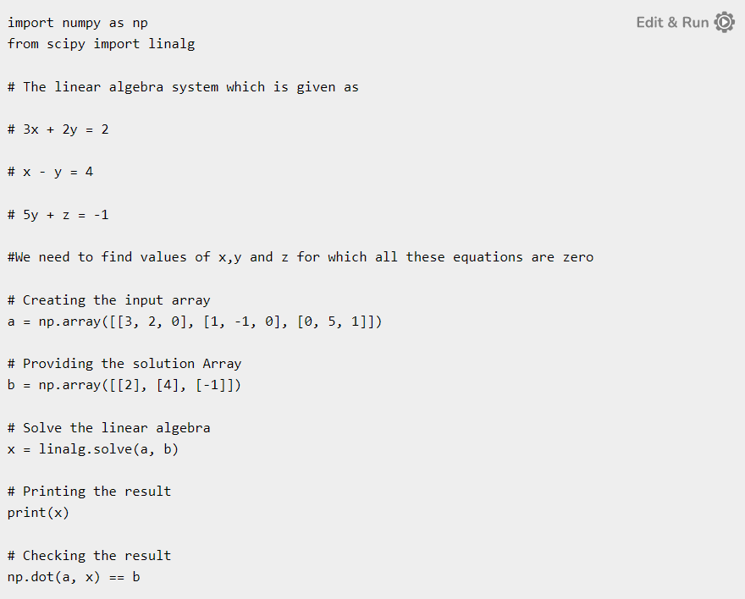
Solve linear equation
Notes:
https://www.tutorialspoint.com/how-can-we-use-the-scipy-library-to-solve-a-linear-equation

Slide 35
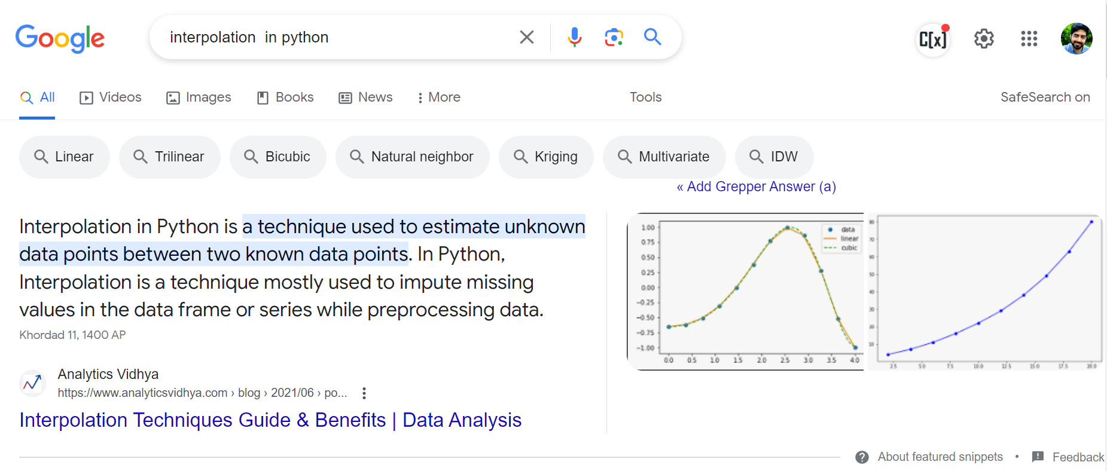
What is interpolation?

Slide 36
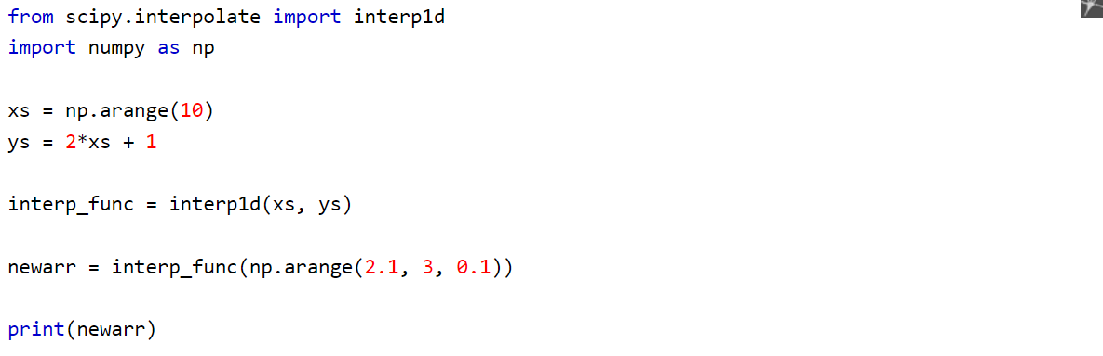
Interpolation with SciPy
Notes:
https://www.w3schools.com/python/scipy/scipy_interpolation.php

Slide 37
Application of Programming in the Digital Age!

Slide 38
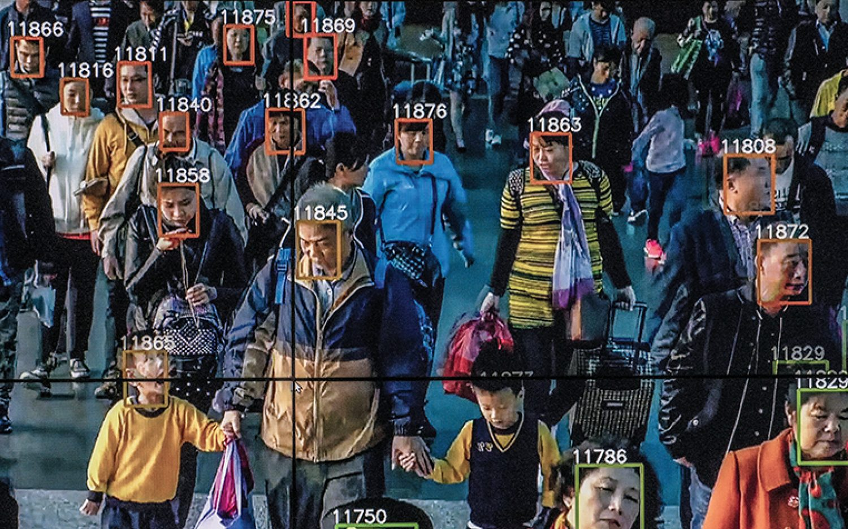
Is it ethical!?
Monitoring

Slide 39
Lecture Resources
https://www.guru99.com/scipy-tutorial.html
https://www.geeksforgeeks.org/numpy-tutorial/
https://www.w3schools.com/python/numpy/default.asp

